Slide 1
英菲尼迪经销商商业计划书 INFINITI Dealer Business Proposal 申请公司全称: Company Application 日期: Date: yyyy-mm-dd

Slide 2
目录Contents
申请公司目前的背景资料
Current Background of Company Application
英菲尼迪经销商商业计划书
INFINITI Dealer Business Proposal

Slide 3
申请公司目前的背景资料 Current Background of Company Application
主要投资人的联系方式 Primary Investor’s Contact
姓名 Name
职务/职位 Title
移动电话 Phone No.
电话 Tel.
传真 Fax
电子邮件信箱 Email
负责提供资料的联系人 Contact Person
姓名 Name
职务/职位 Title
移动电话 Phone No.
电话 Tel.
传真 Fax
电子邮件信箱 Email

Slide 4
申请公司目前的背景资料 Current Background of Company Application
申请公司A的背景资料A background of company application:
注册日期Registered Date:
注册资本Registered Capital:
企业类型 (私营/国营/独资/合资/上市公司):
Type of Enterprise: Private,State-owned,Individual proprietorshipJoint-venture,Listed
主要经营范围Scale of Business:
收入总计Total Revenue:
利润总计Total Profit:
员工人数总计Total Employees:
4S经销店个数总计Total owned 4S Shops:

Slide 5
申请公司目前的背景资料 Current Background of Parent Company
申请公司或主要投资人拥有的所有品牌经销店的股权信息（含4S店，城市展厅以及维修中心）
Shareholder flowchart of mainly owned 4S, 1S, and A/S Workshops by company application or primary investors.
请列明申请公司所控股的所有公司（汽车产业和非汽车产业）
Please include all levels of where there is a majority ownership, including businesses outside the proposed corporate entity (both automotive and non-automotive).
xx%
xx%
...
xx%
xx%
xx%
xx%
...

Slide 6
申请公司目前的背景资料 Current Background of Company Application
申请公司或主要投资人拥有的所有品牌经销店的股权信息:
Shareholder flowchart of mainly owned 4S shops by company application or primary investors
品牌 | 数量 |  |  |  | 城市
 | 运营 | 股权 | 在建 | 股权
例：Audi | 4 | 100% | 2 | 100% | 北京 | 上海

Slide 7
申请公司目前的背景资料 Current Background of Parent Company
申请公司或主投资人拥有的所有品牌经销店（含4S店，城市展厅以及维修中心）的背景
General background of mainly owned 4S, 1S, and A/S Workshops by company application or primary investors.
公司名称 Company Application | 经营品牌 Operational Brands | 授权/开业 时间 Authorized/Opening Date | 设施类型 (4S店/展厅/维修中心) Facility Type (4S shop/CSR/Workshop） | 经营范围: 进口车 国产车 Scope of Business Imported/Domestic produced car

Slide 8
申请公司目前的背景资料 Current Background of Parent Company
申请公司或主投资人拥有的所有品牌经销店（含4S店和维修中心）目前的售后服务财务方面业绩: (单位：千元)General After-sales financial performance of mainly owned 4S and A/S Workshops by company application or main investors.
公司名称/品牌 Company/Brand | 前两年 In the past 2 years |  |  | 前一年 In the past 1 year |  |  | 本年累计 Accumulated data CYTD
 | 服务收入 After-sales (A&S) Revenue | 毛利润 Gross profit | 服务吸收率 Fixed Absorption Rate | 服务收入 After-sales (A&S) Revenue | 毛利润 Gross Profit | 服务吸收率 Fixed Absorption Rate | 服务收入 After-sales (A&S) Revenue | 毛利润 Gross Profit | 服务吸收率 Fixed Absorption Rate
请提供厂家报告佐证。
Provide manufacturer report for validation of score received.

Slide 9
申请公司目前的背景资料 Current Background of Parent Company
申请公司A的背景资料:
Current Background of the parent company group.
主要经营范围 Business Type
注册日期 Registered Date
注册资本(千元) Registered Capital
企业类型:(私营/国营/独资/合资/上市公司) Type of Enterprise: Private, State-owned, Individual Proprietorship Joint-venture, Listed
收入总计(千元) Total Revenue (most recent FYE)
利润总计(千元) Total Profit (most recent FYE)
员工人数总计 Total Employees (most recent FYE)
4S经销店总计 Total Owned 4S Shops (most recent FYE)

Slide 10
申请公司目前的背景资料 Current Background of Company Application
申请公司A的股权结构:
Shareholders Flowchart of Parent Company Group
股东 C
shareholder-C
股东 D
shareholder-D
xx%
xx%
股东 A
shareholder-A
股东 B
shareholder-B
xx%
xx%
申请公司Company application
注：若为自然人股东，请提供官方证明文件。同时，也请在第5页公司组织结构图中提供所有成员的职务及头衔。
Note: If personal ownership, please provide copies of the official record for validation.
Also, please provide Titles and Position of members within the corporate organization (slide 5)

Slide 11
申请公司目前的背景资料 Current Background of Parent Company
申请公司A目前的财务业绩: （单位：千元）
Current financial performance of company application (A unit of investment amount: RMB1,000).
请提供申请公司的合并数据以及第6页中所列的所有经销商的财务数据。
Please provide one form for the parent company as well as for each of the dealerships listed on Slide 6.
 | 前两年 In the past 2 years |  | 前一年 In the past 1 year |  | 本年累计 Accumulated data CYTD
 | 金额 Amount | 增长率 Growth Ratio % | 金额 Amount | 增长率 Growth Ratio % | 金额 Amount | 增长率 Growth Ratio %
总收入 Total Revenue
毛利润 Gross Profit
毛利率 Gross Profit Rate %
净利润 Net Profit
净利率 Net Profit Rate %
净现金流 Net Cash Flow
请提供最近三年的申请公司审计过的合并财务报表以及上述所列全部经销商的财务报表复印件。
Provide copy of audited financial statements for parent company as well as dealership companies for each year.

Slide 12
申请公司目前的背景资料 Current Background of Parent Company
申请公司A目前的财务业绩: （单位：千元）
Current financial performance of company application (A unit of investment amount: RMB1,000).
In addition to filling out the table below, please provide a copy of your most recent audited Balance Sheet.
 | 前两年 In the past 2 years | 前一年 In the past 1 year | 本年累计 Accumulated data CYTD
资产负债率 Debt/Asset Ratio (Total Debt/Total Asset)
流动比率 Working Capital Ratio
速动比率 Quick Ratio
所有者权益 Owner’s Equities (Net Worth)
固定资产 Fixed Assets
货币资金 Cash in Bank
融资保证金 Financing Deposit (including floorplan)
可用于投资的富余自有现金 Sufficient Equity Fund is available for investment.

Slide 13
目录Contents
申请公司目前的背景资料
Current Background of Company Application
英菲尼迪经销商商业计划书
INFINITI Dealer Business Proposal

Slide 14
英菲尼迪经销商商业计划书 INFINITI Dealer Business Proposal
英菲尼迪经销商股权结构图
Shareholders Flowchart of INFINITI Dealer (minimum of 2 levels)
需成立新公司来开展英菲尼迪业务。
Operating INFINITI business requires establishment of a new company.
xx%
xx%
xx%
xx%
xx%
运营主体

Slide 15
英菲尼迪经销商商业计划书 INFINITI Dealer Business Proposal
建议投资计划 - 来源及证明（金额单位：千元）
Investment Plan-Investment source&certificate (A unit of investment amount: RMB1,000)
来源 Source | 金额 Amount | 证明 Certificate
注册资本 Registered Capital
额外实收资本 Additional Actual Receipt Capital
股东贷款 Shareholder Loan
银行贷款 Bank Loan
投资总额 Total Investment

Slide 16
英菲尼迪经销商商业计划书 INFINITI Dealer Business Proposal
建议的组织结构图
The flowchart of suggested organization
投资人
Dealer
Principal
总经理
General
Manager
销售经理
Sales
Manager
服务经理
Aftersales
Manager
市场经理
Marketing
Manager
...

Slide 17
英菲尼迪经销商商业计划书 INFINITI Dealer Business Proposal
建议的英菲尼迪经销商负责人
A suggested primary team members of the INFINITI Dealer
姓名: 性别: 年龄: 学历: 专业:
Name: Gender: Age: Diploma: Major:
时间 Time | 公司 Company | 职位 Job Title | 主要职责/业绩 Main Duties

Slide 18
英菲尼迪经销商商业计划书 INFINITI Dealer Business Proposal
建议的总经理
Suggested General Manager of INFINITI Dealer
姓名: 性别: 年龄: 学历: 专业:
Name: Gender: Age: Diploma: Major:
时间 Time | 公司 Company | 职位 Job Title | 主要职责/业绩 Main Duties

Slide 19
英菲尼迪经销商商业计划书 INFINITI Dealer Business Proposal
建议的销售经理
Suggested Sales Manager of INFINITI Dealer
姓名: 性别: 年龄: 学历: 专业:
Name: Gender: Age: Diploma: Major:
时间 Time | 公司 Company | 职位 Job Title | 主要职责/业绩 Main Duties

Slide 20
英菲尼迪经销商商业计划书 INFINITI Dealer Business Proposal
建议的服务经理
Suggested After-sales Manager of INFINITI Dealer
姓名: 性别: 年龄: 学历: 专业:
Name: Gender: Age: Diploma: Major:
时间 Time | 公司 Company | 职位 Job Title | 主要职责/业绩 Main Duties

Slide 21
英菲尼迪经销商商业计划书 INFINITI Dealer Business Proposal
建议的市场经理
Suggested Marketing Manager of INFINITI Dealer
姓名: 性别: 年龄: 学历: 专业:
Name: Gender: Age: Diploma: Major:
时间 Time | 公司 Company | 职位 Job Title | 主要职责/业绩 Main Duties

Slide 22
英菲尼迪经销商商业计划书 INFINITI Dealer Business Proposal
建议土地
Proposed Land
土地具体位置 Land Location
自有或租赁（如租赁注明租期） Ownership or Lease (if leased, indicate duration of lease)
已获得/意向书/商谈中 Owned/Letter of Land Lease Intent/In Negotiation
大小（面宽x面深） Size (width x depth)
空地/有建筑物 Vacant land/Buildings on the ground
土地用途/属性 Land Usage
周边其它品牌店名称及距离 Competitor’s barnd&location, close to proposed land
离市中心距离/开车时间 Distance from the downtown/time by a drive

Slide 23
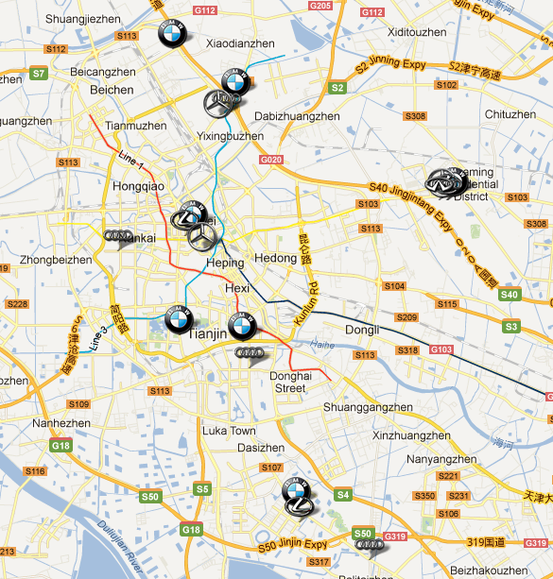
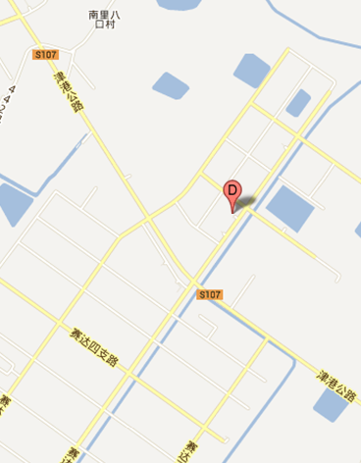
英菲尼迪经销商商业计划书 INFINITI Dealer Business Proposal
城市地图包括竞争对手所处位置和建议的英菲尼迪经销店位置
A city map including competitor’s location and proposed INFINITI 4S shop location.
例
建议土地 – 位置
Propose Land- Location
Infiniti #1
Investor A
700M
19KM
Zhongshun Jinbao
1.2KM
Proposed Land

Slide 24
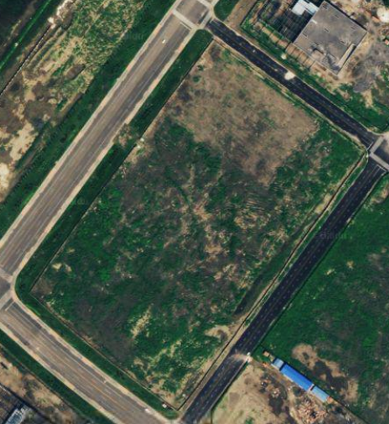
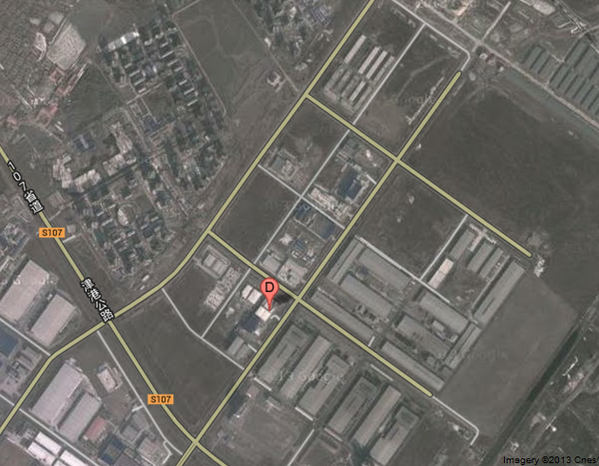
英菲尼迪经销商商业计划书 INFINITI Dealer Business Proposal
例
85M
Investor A
70M
Flagship
Under Construction
applications in process
Under Construction

Slide 25
英菲尼迪经销商商业计划书 INFINITI Dealer Business Proposal
建议土地-照片
Proposed Land-Photos
e
d
g
f
请至少提供如下图所示的各角度照片
Shooting angles are required as below.
例
b
c
a

Slide 26
英菲尼迪经销商商业计划书 INFINITI Dealer Business Proposal
建议土地-红线图
Proposed Land-Red line drawing
红线图需说明土地规划参数或设计要点,包括建筑退线、绿化退线、主入口和其它要求。
Red line drawing is required to include land planning index or core design elements, which includes back to red line, back to greening red line, main entrance and other requirements.

Slide 27
英菲尼迪经销商商业计划书 INFINITI Dealer Business Proposal
建议土地-详细规划信息
Proposed Land-Detailed information
土地总面积 Total area of proposed land
建筑密度 Building Density
建筑投影面积 Building projected area
建筑容积率 Building plot ratio
建筑总面积 Gross area of building
红线内总面宽 Gross area of width inside red line
建筑最大面宽（除退线和内部通道外） The largest area of width (except both back to red line and outside the internal access)
红线内总深度 Gross depth inside red line
建筑最大深度（除退线和内部通道外） The largest depth of building (except both red line set-back and outside the internal access)
绿化率 Greening ratio
建筑限高 Building height restriction
对招牌位置和高度的限制要求 Requirements on signage and limit for building height
请按土地自然状况，红线图或土地规划要求填写
According to actual land status, red line drawing
and land planning, fill in the blanks.

Slide 28
英菲尼迪经销商商业计划书 INFINITI Dealer Business Proposal
建议土地-其他
Proposed Land-Others
影响因素 Adverse factors in construction | 是否为不利因素,如果是,请解释 Adverse factors, Yes or No; if Yes, please illustrate.
有无高压线／塔 High voltage wire/tower, close to proposed land, Yes or No
周边是否有视线障碍物（如高建筑物、山坡） Visual obstacles (such as high buildings, hills), close to proposed land, Yes or No
土地有无异常地质状况 Abnormal geology, close to proposed land, Yes or No
周边有无河流或湖泊 A River or lake, close to proposed land, Yes or No
周边是否有明显噪音 Noisy, close to proposed land, Yes or No
周边是否有明显异味 Smelly, close to proposed land, Yes or No
周边是否有异常震动 Abnormal vibration, close to proposed land, Yes or No
周边是否脏乱 Dirty or messy, close to proposed land, Yes or No
其它 Others
请说明其它影响设计、建筑、招牌、和未来运营的因素
Please illustrate other factors in design,construction,
signage and operations in future

Slide 29
英菲尼迪经销商商业计划书 INFINITI Dealer Business Proposal
建议土地 – 现有状况Current status on proposed land
(请附土地所有权证/土地购买合同/土地租赁合同/土地租赁意向书等)
Please attach land property certificate/land ownership contract/lease on land contract/letter of land lease intent.

Slide 30
英菲尼迪经销商商业计划书 INFINITI Dealer Business Proposal
销售预测 – 当地市场销售分析
General Sales Analysis of local market
当地市场简介(面积,城市影响力,消费习惯等)
Briefing of local market (including area, an influence of this city, consuming habit and so on)

Slide 31
请提供以下材料 Submitting materials as below
营业执照
Business License
汽车行业维修许可证
Automotive Maintenance Permit
申请公司验资报告及最近3年的财务审计报告(申请公司及主要4S店的资产负债表，损益表和现金流量表) An applicant’s verification of capital statements; audited financial statements for recent 3 years
(including company application’s and mainly owned 4S shop’s balance sheet, loss&profit statements and
cash flow statements.）
银行或其他金融机构出具的申请公司资信证明
Credit certificates issued by a bank or other financial organizations.

Slide 32
英菲尼迪经销商商业计划书 INFINITI Dealer Business Proposal
销售预测 – 当地市场数据 Local market data
 | 单位 Unit | 前三年 In the past 3 years | 前两年 In the past 2 years | 前一年 In the past 1 year
人口总计 Total Population | 万人
国内生产总值 GDP | 亿万
人均国内生产总值 GDP per capita | 元
人均收入 Income per capita | 元
家庭银行存款 Household Savings | 亿元
保有车辆总计 Total Units in Operation (UIO) | 辆
豪华汽车保有量 Total Premium Units in Operation (UIO) | 辆
每百户家庭汽车拥有量 Unit in Operation (UIO)/per 100 households | 辆
公路总长度 Total Length of Road | 公里

Slide 33
英菲尼迪经销商商业计划书 INFINITI Dealer Business Proposal
销售预测 – 汽车市场历史数据
Historical data in local auto market
所有 车系 All series of cars | 年保有量 Unit of operation per year |  |  |  | 上牌数 Registered Number |  |  |  | 市场份额 Market Share |  |  |  | 经销商数量 Quantity of Dealers
 | 前三年 In the past 3 years | 前两年 In the past 2 years | 前一年 In the past 1 year | 当年累计 | 前三年 In the past 3 years | 前两年 In the past 2 years | 前一年 In the past 1 year | 当年累计 | 前三年 In the past 3 years | 前两年 In the past 2 years | 前一年 In the past 1 year | 当年累计 | 前三年 In the past 3 years | 前两年 In the past 2 years | 前一年 In the past 1 year | 当年累计
 |  |  |  | 至__月 Accumulated data to_ (Month) in this year |  |  |  | 至__ 月 Accumulated data to_ (Month) in this year |  |  |  | 至 __月 Accumulated data to_ (Month) in this year |  |  |  | 至__月 Accumulated data to_ (Month) in this year

Slide 34
英菲尼迪经销商商业计划书 INFINITI Dealer Business Proposal
销售预测 – 英菲尼迪销量计划
Sales Forecast-INFINITI plan for sales volume
所有目标城市 Total | 第一年 1st Year |  | 第二年 2nd Year |  | 第三年 3rd Year |  | 第四年 4th Year |  | 第五年 5th Year
英菲尼迪销量 INFINITI Sales Volume
英菲尼迪竞争车款总销量 Overall Sales Volume of INFINITI Competitors
英菲尼迪占竞争车款总销量份额 Overall Sales Volume of INFINITI Competitors
豪华市场所有车款总销量 Luxury Total Industry Volume (LTIV)
英菲尼迪占豪华市场总量份额 INFINITI % of LTIV

Slide 35
英菲尼迪经销商商业计划书 INFINITI Dealer Business Proposal
新车销售及保有车辆预估
New Vehicle Sales Forecasts and UIO
车型 model | 销售台次 Sales Unit |  |  |  |  | 保有台数 UIO (Unit in Operation)
 | 第一年 1st Year | 第二年 2nd Year | 第三年 3rd Year | 第四年 4th Year | 第五年 5th Year | 第一年 1st Year | 第二年 2nd Year | 第三年 3rd Year | 第四年 4th Year | 第五年 5th Year
QX50 SUV
QX60 SUV
QX80 SUV
Total 合计

Slide 36
谢 谢
THANKS

